Slide 1
Battle of the neighborhoods

Slide 2
Business Problem
Picking the right location for a business is critical for its success
A successful Canadian businesswoman is looking for a new location to open a coffeeshop
She decided to open the coffeeshop in Downtown Toronto
She believes the best way to determine which neighborhood to open her new business is by analyzing and comparing the different neighborhoods
By doing this, she can make the best data driven decision

Slide 3
Dataset Description
The Toronto neighborhood data was scraped from Wikipedia
It was scraped, cleaned, and put into a pandas dataframe so it can be further analyzed in a structured format
Foursquare API was used to explore the types of venues and their locations in the different Downtown Toronto neighborhoods

Slide 4
Methodology
The Toronto data was processed and explored, with a focus on Downtown Toronto
It was explored using the Foursquare API
This study applied neighborhood segmentation and clustering to analyze the neighborhood data and find the best location to open the coffeeshop
The results were visualized.

Slide 5
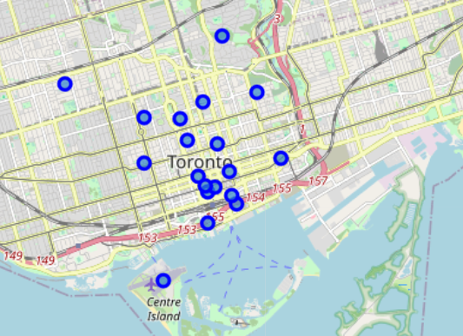
Toronto Data
The folium library was used to visualize geographic overview of Downtown Toronto
It used the latitude and longitude values based on the neighborhoods.

Slide 6
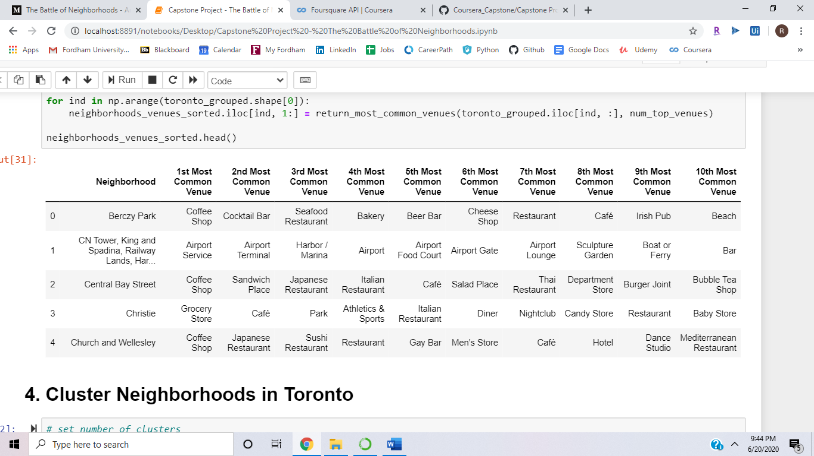
API Visualization
Foursquare API was used to explore the 10 most common venues for each of the neighborhoods.

Slide 7
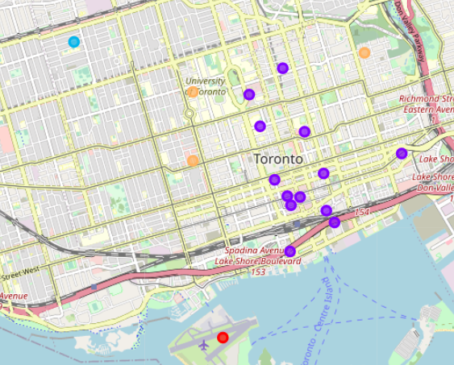
Clustering
The top 10 venues for each neighborhood were found by using K-Means Clustering
The value of the K-clusters was set to 5

Slide 8
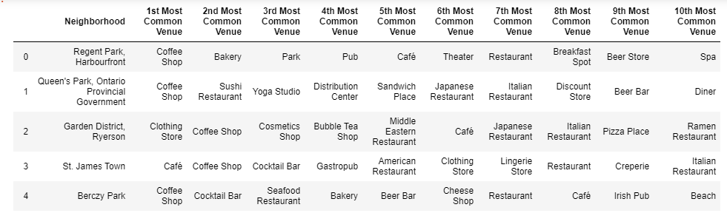
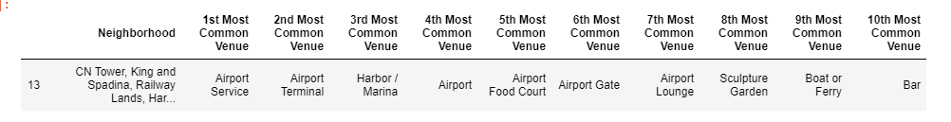
Clusters
Cluster 1
Cluster 2

Slide 9
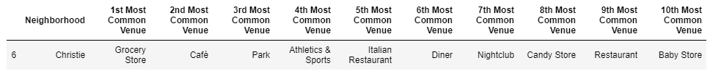
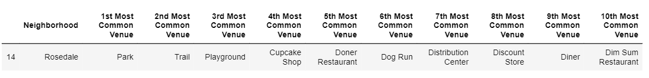
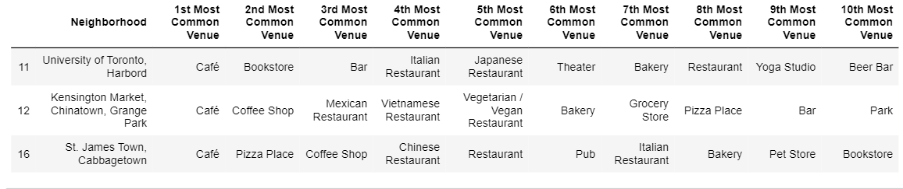
Clusters
Cluster 3
Cluster 4
Cluster 5

Slide 10
Recommendations and Conclusions
Cluster 2 has the most diverse set of venues, including coffee shops, restaurants, and entertainment venues
This indicates that it could attract more foot traffic and opportunities for growth
11/13 of the neighborhoods in cluster 2 have coffee shops as the most common venue type
Opening in a neighborhood in cluster 2 is less risky as there are a diverse set of businesses around, more foot traffic and it has the most popular neighborhoods

